Slide 1
Master Thesis – Introductory seminar
Topic: Design and Prototypical Implementation of a High-Level Synchronization Component for Dynamic Updates of Task Run Queues in L4 Fiasco.OC/Genode
Guru Chandrasekhara
Supervisor: Prof. Dr. Uwe Baumgarten
Advisors: Daniel Krefft,M.Sc.; Sebastian Eckl,M.Sc.

Slide 2
Outline
Motivation
Problem statement
System constraints
Related work
Comparison/Evaluation of existing methods
Design
Implementation/Evaluation

Slide 3
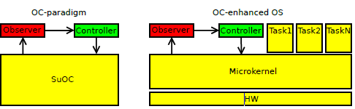
Motivation
KIA4SM – Cooperative Integration Architecture for Future Smart Mobility Solutions
  Communication between Intelligent Transport Systems(ITS)
  Universally applicable ECUs
  Organic computing
  Requirements of KIA4SM
    Flexible scheduling of tasks per ECU
  Observer controller architecture: Decentralised OC
    Observers collect data
    Controllers analyse data
Notes:
Notes:
KIA4SM: In normal vehicles a large number of different micro-controllers used to do the necessary tasks for vehicle controlles. The
aim of the KIA4SM project is to replace them and use more power-full and standardized hardware. multiple distributed
electronic-control-units (ECUs)
The number of accidents in Germany despite the advanced car options, due to lack of drivers problems
The Organic Computing (OC) paradigm addresses the challenges of complex distributed systems by enriching them with life-like (organic) behaviour, resulting in the application of self-* capabilities
Importance of Autonomous driving environment
KIA4SM - Organic computing - aims to solve the problem by KIA4SM project – One of the main gola of KIA4SM is
Mechanisms that allow for online dynamic reconfiguration –
flexible scheduling of tasks per ECU
Organic computing – importance of organic computing in developing a safety critical system

Slide 4
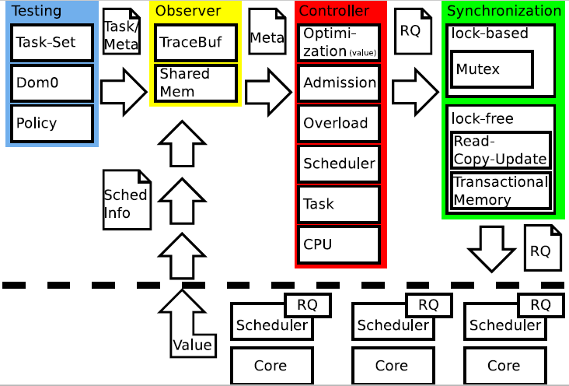
Problem Statement
Controller produces a new
Run Queue(RQ)
  Update the run queue
  Start executing new run queue
Producer-Consumer problem
Synchronization of Run Queue

Slide 5
System constraints
Real time system requirements
  Safety – Hard real time system
  Efficiency – Embedded system
  Utilization – Threads should reach their deadline
  Predictable thread synchronization mechanism
Organic-Computing-Compatibility

Slide 6
Related work: Synchronization Methods
Synchronization methods
Lock-based
Lock-Free
Mutex
Semaphore
Spin-lock
Read Copy Update
STM
Atomic operations

Slide 7
Lock-based: Mutex
Simple
Easy to implement
Only one thread can access/Modify at a time
Deadlocks
Priority inversion
Starvation

Slide 8
Lock-free: Read Copy Update
Concurrent read and write operations to the same data
Three fundamental mechanisms
  Publish-Subscribe Mechanism (for insertion)
  Wait For Pre-Existing RCU Readers to Complete (for deletion)
  Maintain Multiple Versions of Recently Updated Objects (for readers)
Publish-Subscribe Mechanism
  Publish: Execute pointer update in right order
  Subscribe: Fetch the data in right order
    Memory barrier and compiler directives
Notes:
p->a = 1;
p->b = 2;
p->c = 3;
rcu_assign_pointer(gp, p);
rcu_read_lock();
p = rcu_dereference(gp);
if (p != NULL) {
do_something_with(p->a, p->b, p->c);
}
rcu_read_unlock();

Slide 9
Lock-free: Read Copy Update(2)
  Wait For Pre-Existing RCU Readers to Complete
  Deletion of element from linked list
  Grace period

Slide 10
Lock-free: Read Copy Update(3)
Advantages
  Concurrent access to shared data structure
  Low computation and storage overhead
  Deterministic completion time
Drawbacks
  Not a great tool when there are multiple writers
  Inconsistent data at times
  Difficult to implement

Slide 11
Lock-Free: Software Transactional Memory
Concurrency control paradigm that provides atomic and isolated execution for regions of code
Atomicity, Isolation
Language extensions are required
  Data versioning and conflict detection
Global state of the program is consistent
GCC 4.7
  Eg:
void testfunc(int *x, int *y) {
__transaction_atomic {
*x += *y;
}
}

Slide 12
Lock-Free: Software Transactional Memory(2)
Advantages
  Lock-free code is hard to implement
  More reliable performance
  Easy to Code (Uses language extensions)
  No-deadlocks
  Nested transactions are fine
  Compiler/Runtime figures out conflicts
Limitations
  Running expensive operations multiple times
  Overhead of transactional monitoring
  Difficult to debug
  On fewer cores(<4) performance is not increased

Slide 13
Lock-Free: Atomic operations
Compare and Swap(CAS)
  Basic primitive for many lock-free algorithms
  Handled by CPU instructions
  Atomically update by comparing memory contents to a given value, if value is same then update
  Perform this operation repeatedly in a loop until it succeeds
Limitations:
  ABA problem
  Considerable overhead (both time and space)
int CAS(int *ptr,int oldvalue,int newvalue)

Slide 14
Evaluation of Existing methods
 | Mutex | RCU | STM
Implementation | + | -- | ++
Read-speed | -- | ++ | +
Write-speed | -- | + | +
Deadlocks | -- | ++ | +
Overhead | + | ++ | --
Security/Consistency | ++ | - | +

Slide 15
Design
Finding the right point for synchronization
  The current running thread should execute
  System should not go into unsafe state
Empty Run Queue (RQ)
Static point in time
Variable point in time
T1 | T2 | Tidle
T1 | T2 | T3
Notes:
What should it cover?

Slide 16
Implementation/Evaluation
Includes getting the RQ from Controller and Switching it successfully with existing RQ
Successful execution of new task set/RQ
Finding the Ideal time for switching the run queue
Benchmarking different synchronization methods for
  Speed
  Safety

Slide 17
Timeline
Apr 15 – May 15 | May 15 – Jun 15 | Jun 15 – Jul 15 | July 15 – Aug 15 | Aug 15– Sept 15 | Sept15 – Oct 15
Research and Related work | Design | Implementation | Implementation Testing | Testing Benchmarking | Write up

Slide 18
Conclusion
KIA4SM project
  Flexible scheduling of tasks per ECU
  Dynamic thread scheduling necessary to get fault – tolerant system
Observer-Controller Architecture
  Produce-Consumer problem
  Run queue(RQ) synchronization
  Finding right method and time for synchronization
State of the Art algorithms
  Lock-based: Mutex
  Lock-Free: RCU, STM
Theoretically RCU gives us the best choice in Lock-Free algorithms

Slide 19
References
KIA4SM - Sebastian Eckl, Daniel Krefft, Uwe Baumgarten
Software transactional memory in gcc - Dave boutcher
  GCC benchmarking with STM, Locks
What Is RCU? - Paul E. McKenney, IBM Distinguished Engineer
  RCU fundamentals
Software Transactional Memory, Siyuan Zhou
  STM basics, comparison to locks
A Framework for Implementing Objects and Scheduling Tasks in Lock-Free Real-Time Systems - James H. Anderson and Srikanth Ramamurthy
  RCU usage in real time systems
Extending RCU for Realtime and Embedded Workloads: Paul E McKenney

